Slide 1

INTRODUCTION TO ENGINEERING
GRAPHICS

Slide 2
CONTENTS
Definition
Importance
Course Objectives
Syllabus
Evaluation Pattern
Text Books

Slide 3
1. Definition of Engineering Graphics
Engineering:
It is the branch of science in which raw materials are converted into useful products.
Graphics:
Describing any information through graphically
Notes:
M Subba Rao, Asst. Prof., MITS, Madanapalle

Slide 4
1. Definition of Engineering Graphics
What is Engineering Graphics?
Graphical expression of technical details without the barrier of a language.
Universal language for engineers
Engineering Graphics is the field of graphical problem solving.
Engineering graphics is a drawing of an object that contains all information like actual shape, accurate size, manufacturing methods, etc., required for its construction.
Notes:
M Subba Rao, Asst. Prof., MITS, Madanapalle

Slide 5
2. Importance of Engineering Graphics
Improves communication skills
Drawings are the road maps to manufacture products and structures
Improves the imagination skills
It is important for all branches of engineering
No construction or manufacturing of any engineering objects is possible without engineering drawing
Notes:
M Subba Rao, Asst. Prof., MITS, Madanapalle

Slide 6
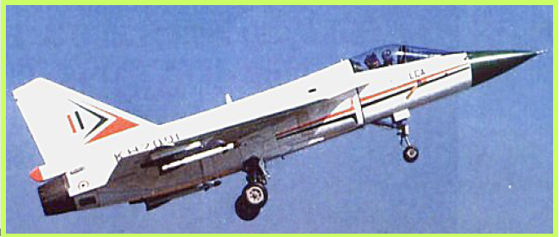
2.1 Importance of Engineering Graphics
Improves the communication skills
• We grasp information easily if it is illustrated with
diagrams, sketches, pictures, etc.
LCA - the world's smallest, light weight, multi-role
supersonic combat aircraft of the world
Notes:
M Subba Rao, Asst. Prof., MITS, Madanapalle

Slide 7

Source: http://img.stern.de/_content/53/96/539645/A380_500_artikel_500.jpg
AIRBUS A380
Details: largest passenger jet. 80m wingspan and a tail that stands as high as a seven-storey building, carries more than 550 passengers.
Notes:
M Subba Rao, Asst. Prof., MITS, Madanapalle

Slide 8
It would just be impossible to communicate all necessary details about the LCA/ Airbus A380 verbally or in writing. picture or drawing is useful.
• A picture/drawing is worth a thousand words..
• The LCA/Airbus A380 would be impossible to create without computer graphics and drawing models.
Notes:
M Subba Rao, Asst. Prof., MITS, Madanapalle

Slide 9

2.2 Drawings are the road maps to manufacture products and structures.
Impossible to describe the details of the building without a drawing.
Notes:
M Subba Rao, Asst. Prof., MITS, Madanapalle

Slide 10
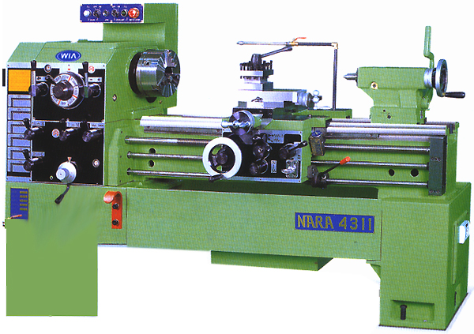
Difficult to describe the details of the machine
Notes:
M Subba Rao, Asst. Prof., MITS, Madanapalle

Slide 11


Chemical reactor
Notes:
M Subba Rao, Asst. Prof., MITS, Madanapalle

Slide 12
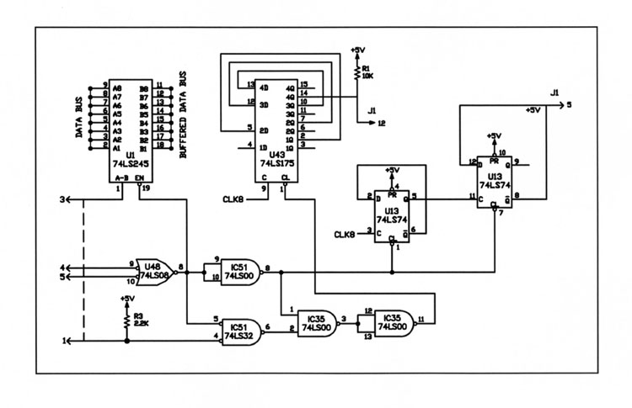
Electrical circuit
Notes:
M Subba Rao, Asst. Prof., MITS, Madanapalle

Slide 13

WITHOUT A GOOD KNOWLEDGE OF ENGINEERING GRAPHICS, ENGINEERS AND SCIENTISTS ARE NO WHERE. AN ENGINEER OR A SCIENTIST NEEDS SKILL IN THREE AREAS: FIRST, HE MUST BE ABLE TO IMAGINE SECONDLY, HE MUST BE ABLE TO DRAW CLEARLY AND RAPIDLY, THIRDLY, HE MUST BE ABLE TO READ THE DRAWINGS DRAWN BY OTHERS.
BY STUDYING ENGINEERING GRAPHICS, STUDENT BECOMES AWARE OF HOW INDUSTRY COMMUNICATES TECHNICAL INFORMATION. ENGINEERING GRAPHICS TEACHES THE PRINCIPLES OF ACCURACY AND CLARITY IN PRESENTING THE INFORMATION NECESSARY TO PRODUCE PRODUCTS. FINALLY IT DEVELOPS THE IMAGINATION SKILL THAT IS ESSENTIAL TO THE CREATION OF SUCCESSFUL DESIGN.
2.3 Improves the imagination skills

Slide 14
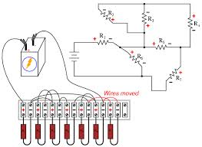
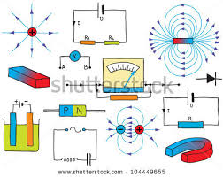
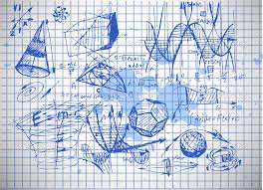





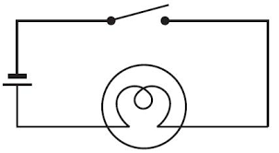
Drawing is important for all branches of engineering.
Notes:
M Subba Rao, Asst. Prof., MITS, Madanapalle

Slide 15

Course Objectives
To learn the AutoCAD tool
2. To learn the theory of projections
3. To learn the descriptive geometry
4. To learn a 3-D imaginational skill
Notes:
M Subba Rao, Asst. Prof., MITS, Madanapalle

Slide 16
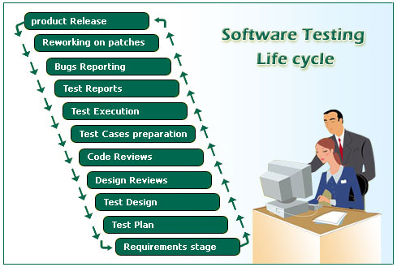
COURSE COVERAGE
AutoCAD
Theory of Projections
Descriptive Geometry
Notes:
M Subba Rao, Asst. Prof., MITS, Madanapalle

Slide 17
SYLLABUS
UNIT-I
Introduction to Computer Aided Engineering Graphics:
Introduction, AutoCAD User Interface, BIS conventions, Dimensioning. Generation of points, lines, curves, polygons, dimensioning, layers, blocks. Geometrical constructions
UNIT-II
Orthographic Projections:
Projections of Points. Projections of Lines parallel and inclined to both the planes.

Slide 18
SYLLABUS
UNIT-III
Projections of planes: Projections of regular planes, plane inclined to both the planes.
Projections of Solids: Projections of regular solids, Solids inclined to one plane.
UNIT-IV
Isometric Projections :
Principles – Isometric Scale – Isometric Views. AutoCAD 3D interface. Plane Figures and Simple Solids.

Slide 19
SYLLABUS
UNIT-V
Transformation of Projections:
Conversion of Isometric Views to Orthographic Views and Vice-Versa in AutoCAD

Slide 20
EVALUATION PATTERN
Assignments,
Day to day evaluation & Attendance 10 Marks
2) Minor-I Exam 15 Marks
3) Minor-II Exam 15 Marks
4) Workshop 20 Marks
5) End Semester Exam 40 Marks
Total 100 Marks

Slide 21
ASSIGNMENTS EVALUATION
Total 5 Assignments: one assignment from each unit. Assignment problems are given to the students immediately after starting the unit syllabus .
Average marks of all the assignment is the final assignment marks.

Slide 22
MID TEST EVALUATION
MINOR Test Pattern:
3 Questions need to answer out of 4 Questions. Each question carries 5 marks.
Syllabus for MINOR Exam:
2.5 units for MINOR-I
2.5 to 5 units for MINOR-II.

Slide 23

DAY TO DAY EVALUATION
In this semester you get 15 to 20 weeks. In every lab your progress will be evaluated and assign to 10 marks. If you absent for the lab then zero marks.
Average of all the marks is equal to the final marks.
Notes:
M Subba Rao, Asst. Prof., MITS, Madanapalle

Slide 24
END SEMESTER EXAM:
Weightage: 40 Marks
Total Ten Questions: Each section is from its respective unit and in each section, there are two questions 1 and 2. Either 1 or 2 can be answer.

Slide 25
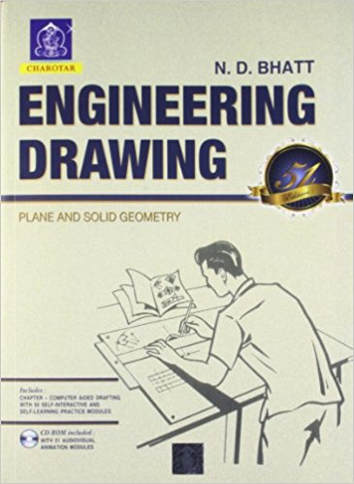
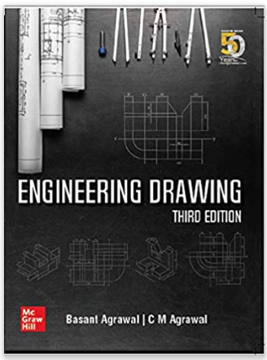
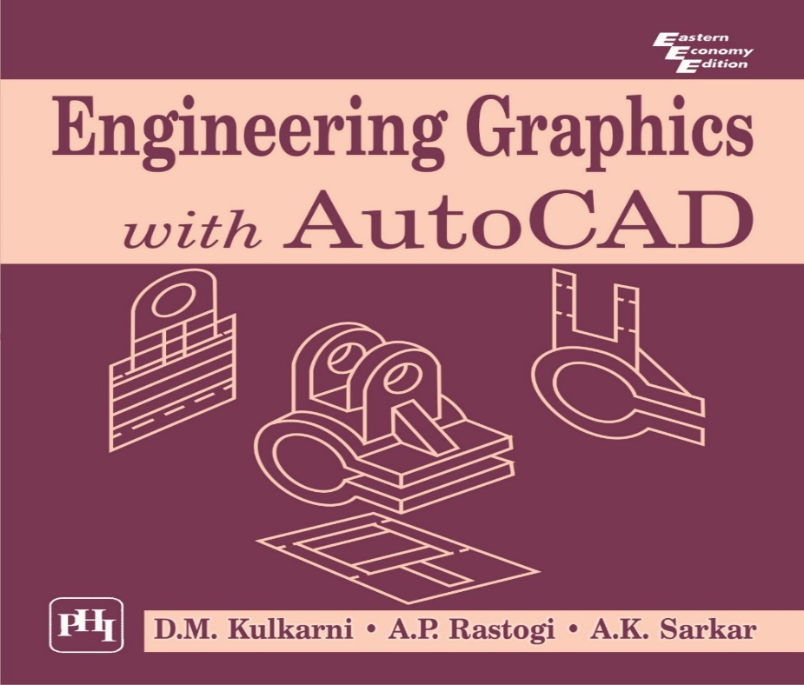

Slide 26
LINES

Slide 27
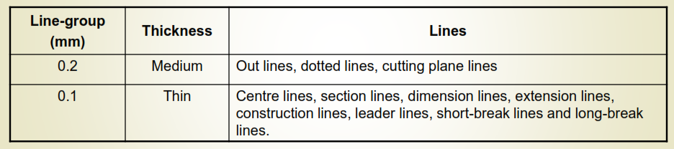
LINES
Line Thickness:
Thickness varied according to the use of pen or pencil and the size & type of the drawing.
For pencil, the lines can be divided into two line-groups:
IMPORTANT NOTES:
In the finished drawing, all lines except construction lines should be dense, clean and uniform.
Construction lines should be drawn very thin and faint and should be hardly visible.

Slide 28
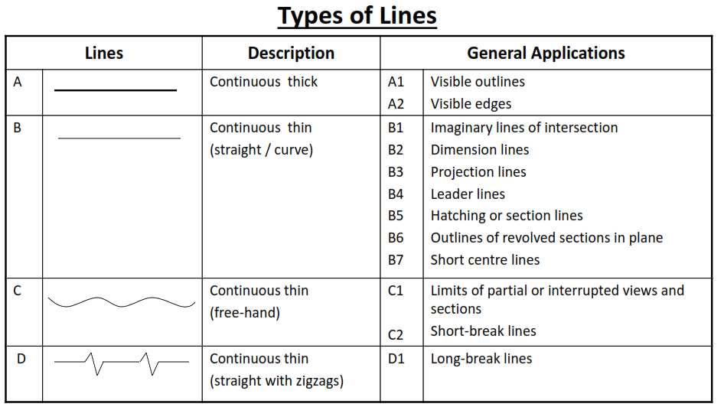

Slide 29
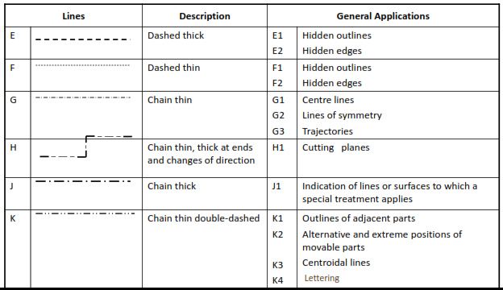

Slide 30
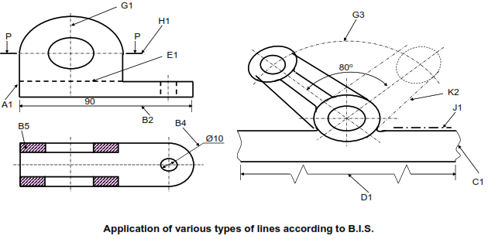

Slide 31
LECTURE 4
DIMENSIONING

Slide 32
DIMESIONING
The information of size on the drawing is called “Dimensioning”. It plays an important role as it helps in giving the correct and accurate size of the part to be manufactured.
Drawing without dimensions is meaningless The elements of dimensioning are:
    Dimension line
    Extension line
    Arrowheads
    Dimension figures
    Leaders
    Notes
Dimension lines should always be parallel to the line it dimensions.
Extension line should extend slightly beyond the dimension line.

Slide 33
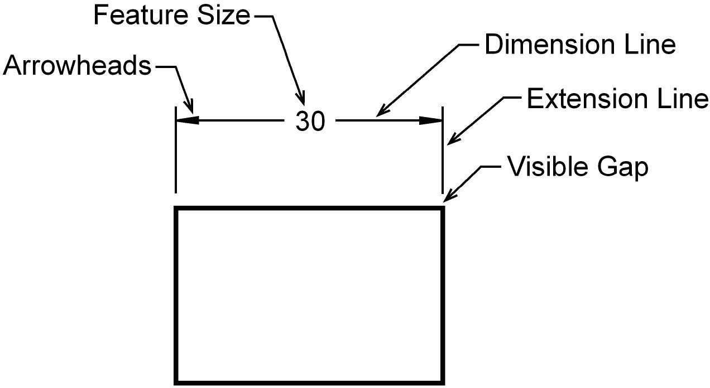
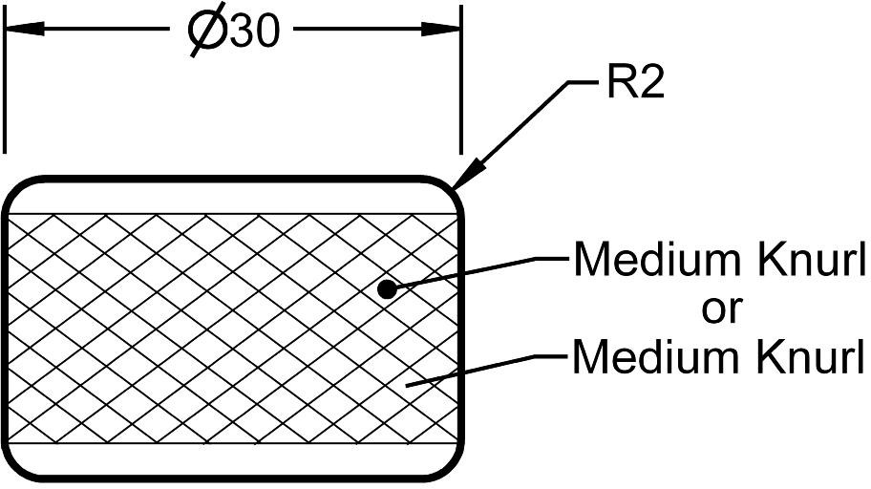

Slide 34
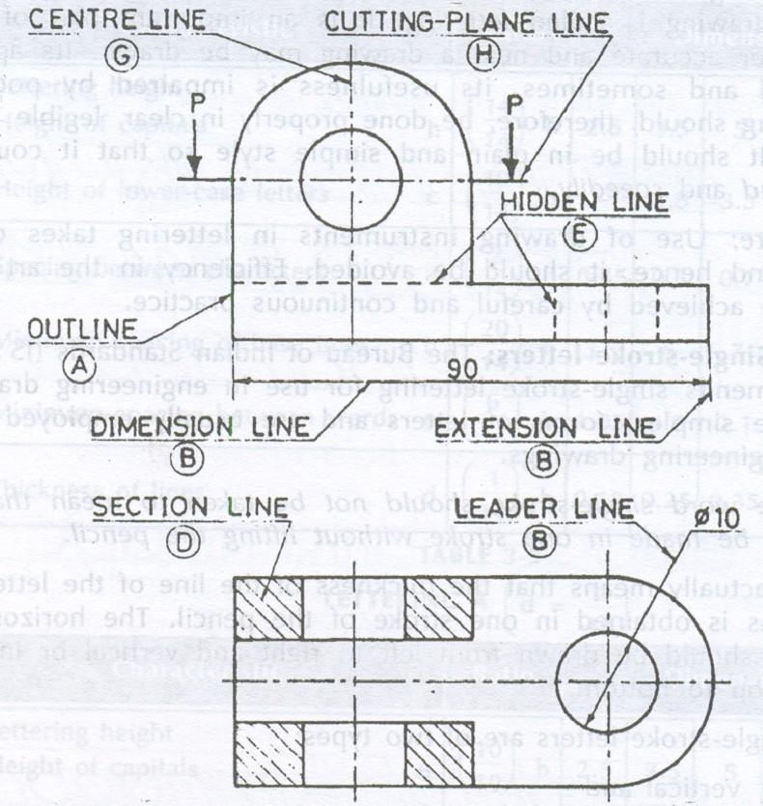

Slide 35
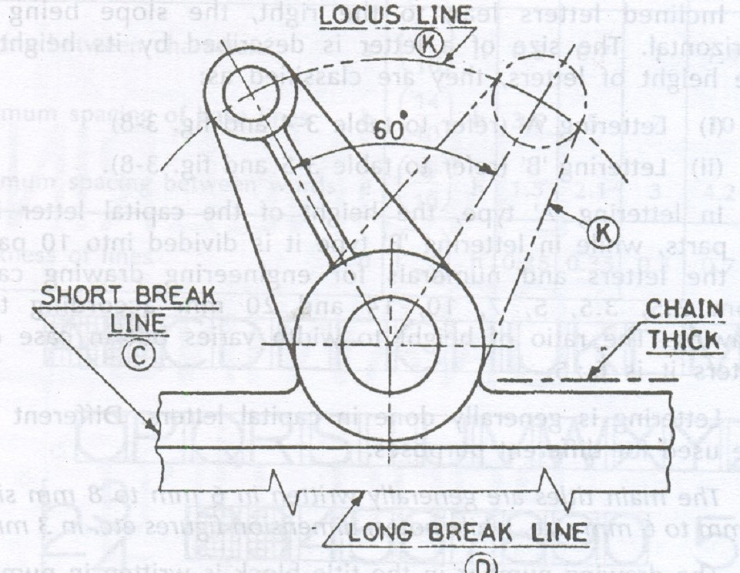

Slide 36
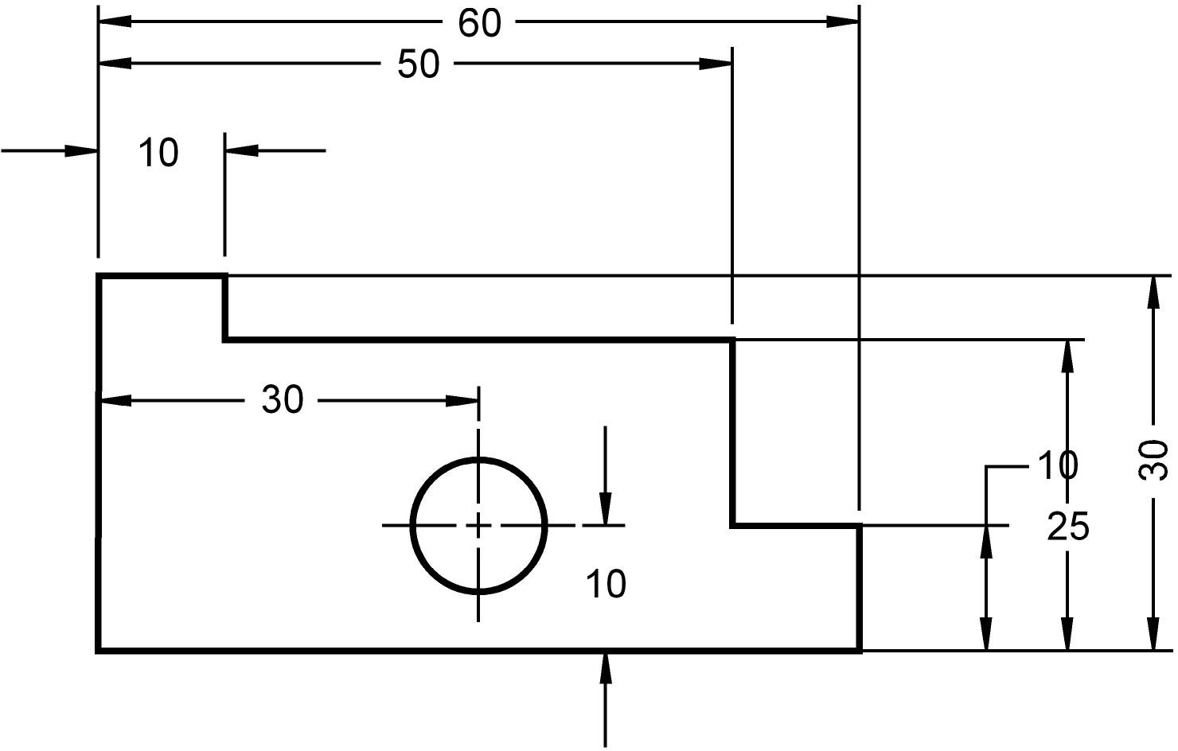
WHAT ARE THE 6 DIMENSIONING MISTAKES?

Slide 37
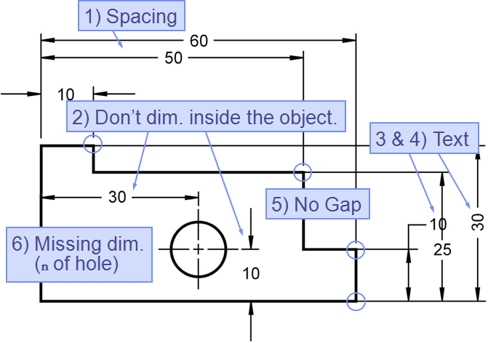
MISTAKES ARE:

Slide 38
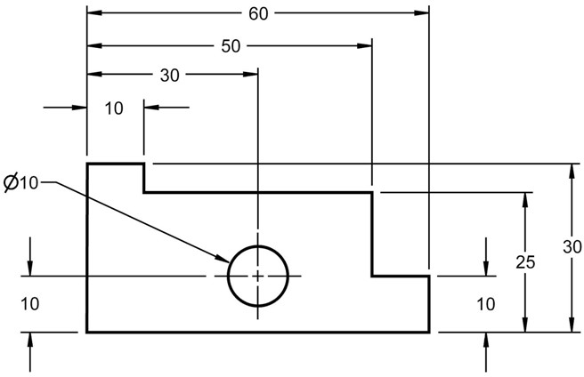

Slide 39
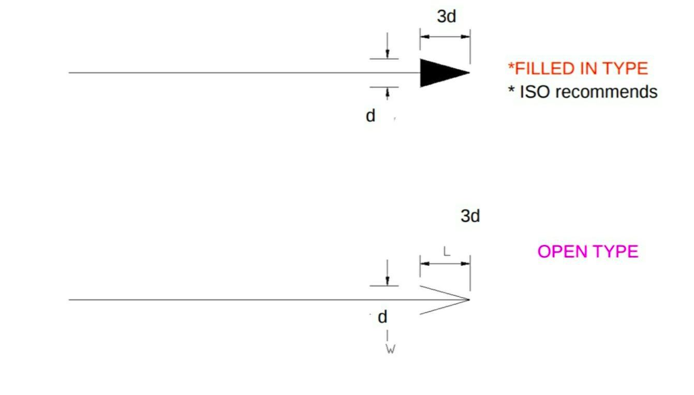

Slide 40
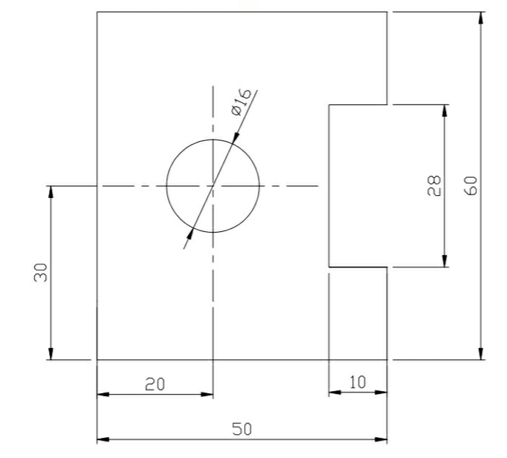
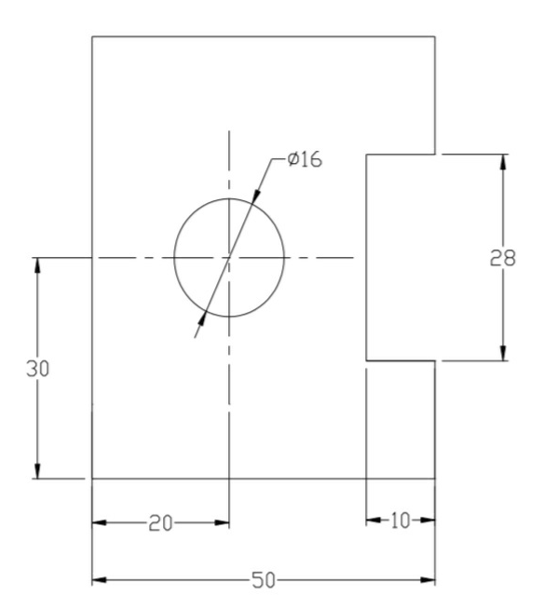
SYSTEM OF DIMENSIONING
ALIGNED SYSTEM
UNI-DIRECTIONAL SYSTEM

Slide 41
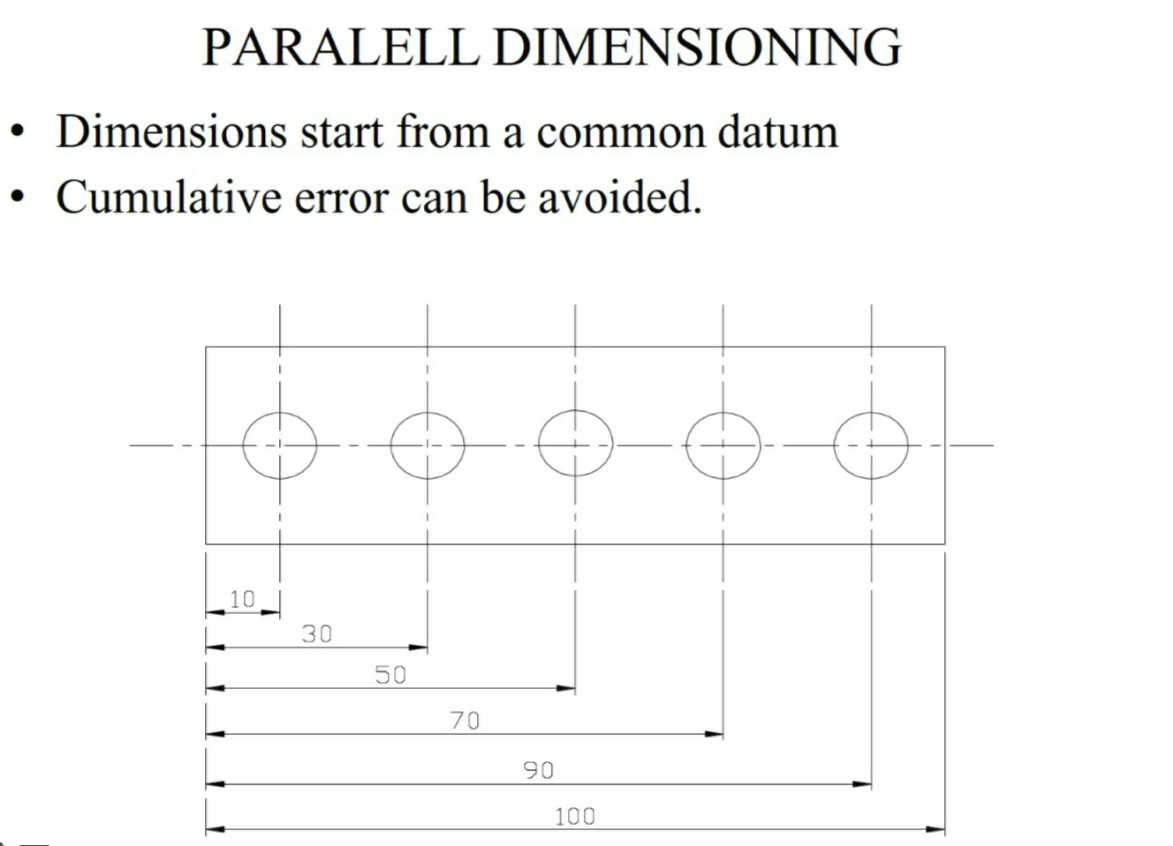

Slide 42
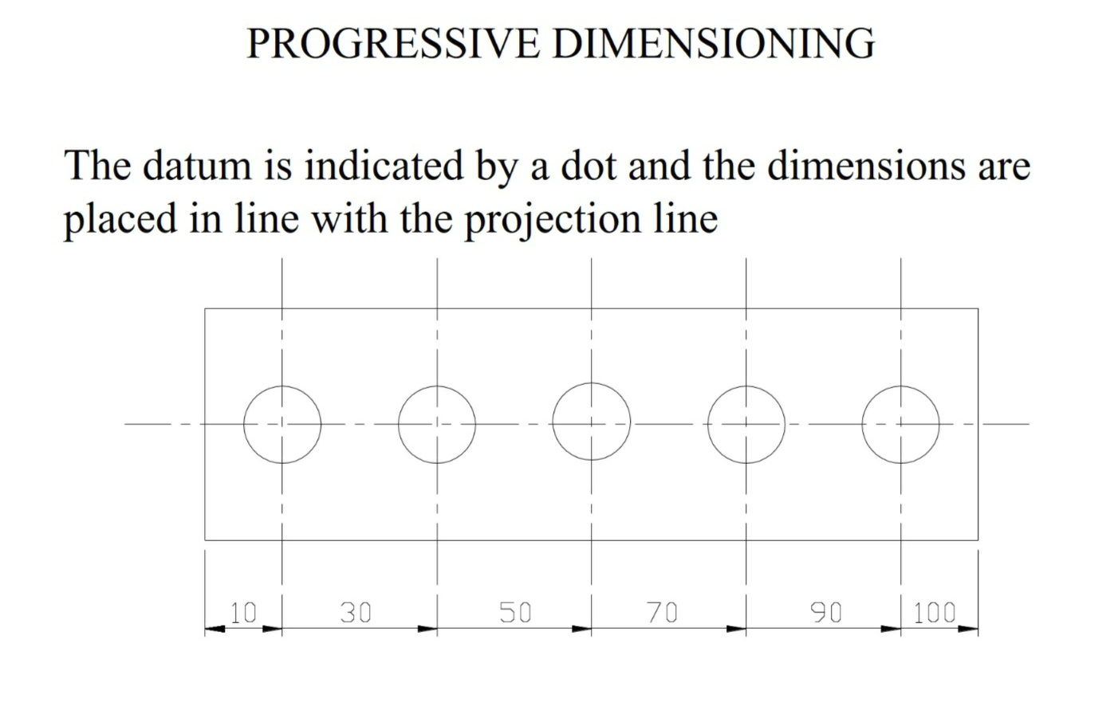

Slide 43
SOME IMPORTANT RULES FOR DIMENSIONING
All the dimensions necessary for the correct functioning of the part should be expressed directly on the drawing.
Every dimension should be given, but none should be given more than once.
A dimension should be placed on the view where its use is shown more clearly.
Dimensions should be placed outside the view, as for as possible.
Mutual crossing of dimension lines and dimensioning between hidden lines should be avoided. Also it should not cross any other line of the drawing.
An outline or a centre line should never be used as a dimension line. A centre line may be extended to serve as an extension line.
Aligned system of dimensioning is recommended.
Dimension lines should be drawn at least 8 mm away from the outlines and from each other.
The extension line should be extended by about 3 mm beyond the dimension line.

Slide 44
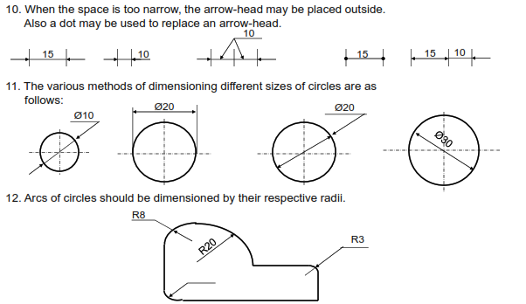

Slide 45
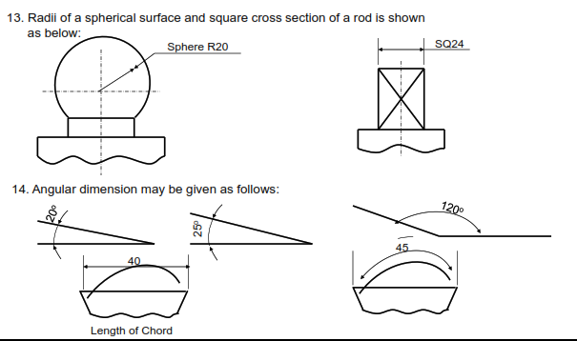

Slide 46
